Slide 1
Midterm Project Presentation
PROJECT TITLE
by
G Jaya Vikram
Reg No. 210907254
Under the guidance of
Internal Guide External Guide
Name : Dr. Prashanth Barla Name: Sharwan Kumar
Asst. Professor Delivery Manager

Slide 2
Contents
Introduction
Background theory/literature review
Work done till date
Result analysis (if any)
References

Slide 3
Introduction
Problem Statement:
Medora Heath Hospital relies on external APIs for labs, insurance, and pharmacies. Frequent API failures disrupt patient care, billing, and medical decisions.
Objective:
Develop a testing framework to ensure HMS reliability by mocking external APIs, simulating various responses (successes, failures, timeouts), and validating error-handling mechanisms.
Solution Highlights:
Mockito for mocking APIs.
Spring Boot for building Backend.
Angular for Interactive Frontend.
JUnit/TestNG for testing.
CI/CD pipelines for automated validation.

Slide 4
Background theory/literature review
Hospital Management System (HMS):
Manages patient records, appointments, billing, and medical history.
Relies on external APIs for seamless data exchange.
Challenges in Existing Systems:
Dependency on live API testing.
Lack of robust error-handling mechanisms.

Slide 5
Work Done till Date
Backend Development:
RESTful APIs implemented using Spring Boot.
CRUD operations for patients, doctors, and appointments.
Sample Code – Patient Management API:
@PostMapping("/patients-info")
public Patient createPatient(@RequestBody Patient patient) {
return patientRepository.save(patient);
}

Slide 6
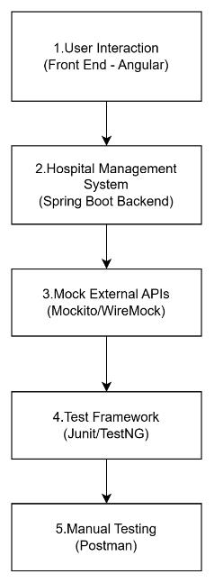
Methodology

Slide 7
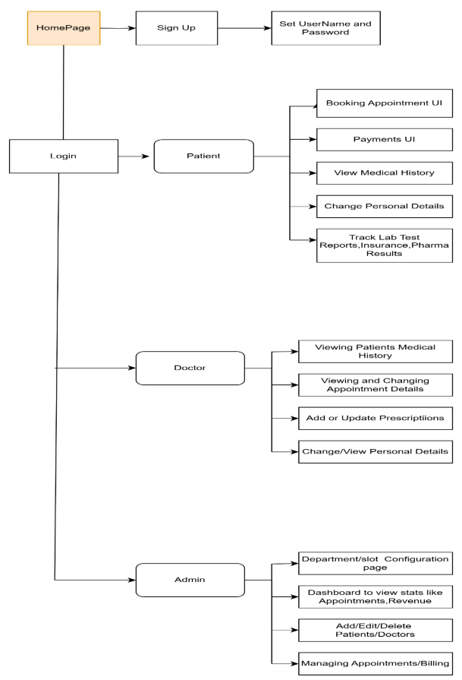
Methodology

Slide 8
Methodology
Front End Technology Stack:
HTML, CSS, Bootstrap – Design UI
JavaScript/TypeScript
Angular Framework
Fetch API – To Communicate with Backend
Form Validation, alerts etc.
Backend Technology Stack:
Spring Boot REST APIs
MySQL DB’s
Authentication using Spring security
External API Integration

Slide 9
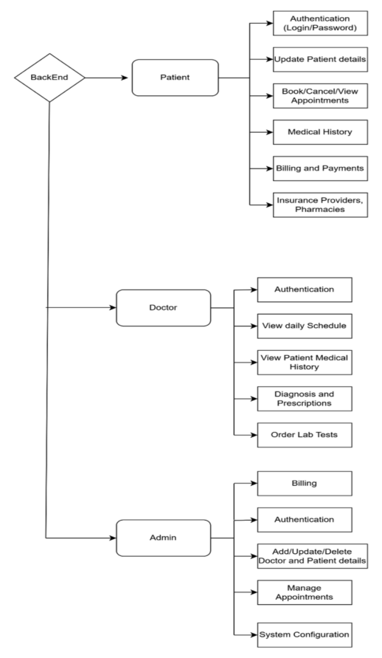
Methodology

Slide 10
Methodology
DATABASE - MYSQL
Patient Database part:
Tables required are:
Patients
Appointments
Billing
Medical history etc.
Doctor Database part:
Tables:
Doctors
Appointments
Lab Requests
Admin Database part:
Admins
User management

Slide 11
Methodology
Manual Testing:
Manual Testing can be done by using
Postman- A testing and Development tool to send HTTP Requests, test API Responses
UI Testing like button clicks, form validation etc.

Slide 12
Result analysis
API Response Time Improvement: | API Endpoint | Pre-Implementation | Post-Implementation | |---------------------------|--------------------|---------------------| | POST /patients-info | 450 ms | 230 ms | | GET /appointments | 520 ms | 310 ms |
Error Recovery Rates: | Error Scenario | Pre-Recovery Rate | Post-Recovery Rate | |-----------------------------|-------------------|--------------------| | Lab API Timeout | 62% | 94% | | Insurance API Failure | 68% | 96% |

Slide 13
Conclusion and future work
Conclusion:
The project successfully addressed challenges caused by unreliable third-party APIs.
Achievements:
Reduced test execution time from 47 minutes to 8 minutes.
Achieved a recovery rate of over 94% for simulated API failures.
Future Work:
Develop an Angular-based frontend for real-time monitoring and user-friendly interfaces.
Implement advanced retry mechanisms with exponential backoff strategies.
Integrate a comprehensive billing module for insurance claims and secure payments.

Slide 14
References
John Doe and Jane Smith, “Developing a Robust Testing Framework for Hospital Management Systems,” Journal of Healthcare Software Engineering, vol.12, pp.45–56, April 2025.
Mockito Documentation, Mockito.org (Web Reference).
Spring Boot Testing Guide, Spring.io (Web Reference)

